Slide 1

CAR PRICE PREDICTION: FORD
PREPARED BY :
JAINAV MUTHA
DEEP MEHTA
SATHVIK REDDY
CHAITNA MANKALA

Slide 2
Introduction
In an era marked by rapid technological advancements and evolving consumer preferences, the automotive industry stands at the forefront of innovation.
Demand for vehicles continues to grow.
We aim to develop a comprehensive price prediction model.
Through this exploration, our objective is to provide valuable insights for both consumers.
Company reviews sentiment analysis

Slide 3
About Dataset
model - > Ford Car Brands
year - >Production Year
price - >Price of car in $
transmission - > Automatic,Manual, Semi-Auto
mileage -> Number of miles traveled
fuel_Type -> Petrol,Diesel,Hybrid,Electric,Other
tax -> Annual Tax
mpg - > Miles per Gallon
engineSize - > Car's Engine Size

Slide 4
Preprocessing of Dataset
Elimination of Null Values
Check for duplicate values
Negative values in price attribute
Changing of categorical data

Slide 5
Why is scaling important?
We used the Min-Max Scalar Technique to help Normalize the data
This normalization step is valuable for preventing any feature from disproportionately influencing analyses.

Slide 6
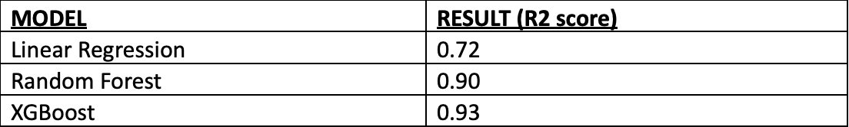
Model Building
We used multiple prediction models to check for the best ones.
The results are below:-
The results using XGBoost are, mean absolute error: 828.011, root mean squared error: 1219.679, R2 score: 0.931.

Slide 7
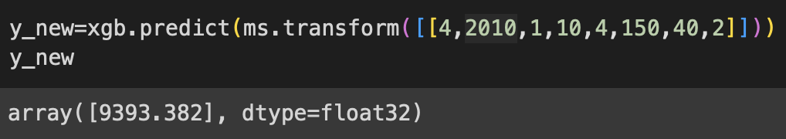
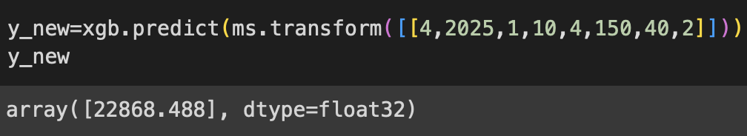
Prediction
Next we used the XGBoost algorithm to get the cost of a same model of Ford car in the year 2010 and in 2025.
The results are below:
2010:-
2025:-
Here we can see how the same car’s price has increased by more than 2 times over 15 years.

Slide 8
Sentiment Analysis
Understanding consumer sentiments is pivotal in today's competitive automotive landscape.
Analyzing how customers feel about brands and products helps in strategic decision-making.
In the age of social media, sentiments can significantly impact brand perception and market trends.
Notes:
Now we delve into sentiment analysis.
In a market saturated with choices, understanding consumer sentiments is not just insightful but crucial for automakers.
As we navigate through this presentation, consider the impact of sentiments on brand perception, customer loyalty, and overall market dynamics.

Slide 9
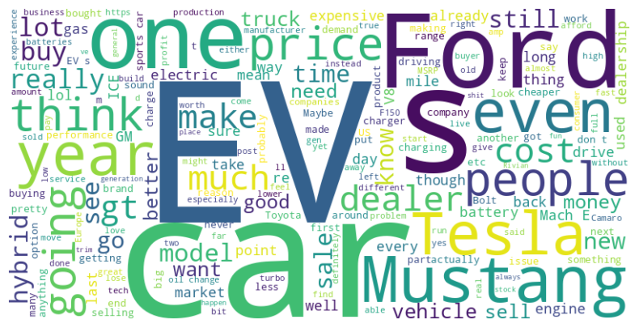
Word Clouds
EV: "Emphasizes Ford's commitment to the electric vehicle revolution."
Mustang: "Leveraging the iconic Mustang brand to create excitement and allure."
Hybrid: "Highlighting Ford's dedication to offering a range of sustainable options."
Cost: "Communicating the value proposition, making sustainable mobility economically viable."
Tesla: “Indicating Ford's response to Tesla's leadership in the electric vehicle market”
Notes:
"Firstly, the term 'EV' stands out prominently. This emphasizes Ford's dedication to driving the electric vehicle revolution forward."
"Moving to the next point, 'Mustang,' we see how Ford leverages the iconic Mustang brand to not just introduce electric vehicles but to create genuine excitement."
"The term 'Hybrid' speaks to Ford's dedication to sustainability. It's not just about electric vehicles; it's about offering a range of sustainable options, marrying traditional and modern technologies."
"Cost is a significant theme, indicating that Ford is not only about innovation but also about making sustainable mobility economically viable for a broader audience."
"Lastly, the presence of 'Tesla' in our WordCloud is notable. It suggests a growing trend of comparison, indicative of Ford's response to Tesla's leadership in the electric vehicle market. "

Slide 10
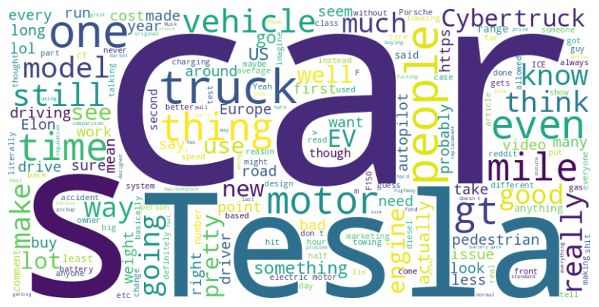
Word Clouds
FORD | TESLA
MUSTANG, GT | CYBERTRUCK, MODEL S
MILEAGE | BATTERY
COMFORT | CHARGING NETWORK
HYBRID | AUTOPILOT
Notes:
This comparison highlights the diversity in approaches between Ford and Tesla in terms of vehicle types, technologies, and consumer priorities."
"While Ford leverages its heritage and expertise in traditional vehicles, Tesla sets the standard for innovation in electric and autonomous driving technologies."
MUSTANG, GT vs. CYBERTRUCK, MODEL S:
Ford (Mustang, GT): Iconic models, synonymous with power and design.
Tesla (Cybertruck, Model S): Disruptive design and cutting-edge features set new standards.
MILEAGE vs. BATTERY:
Ford (Mileage): Focus on traditional vehicles with varying fuel efficiencies.
Tesla (Battery): Emphasis on longer battery range, reducing range anxiety.
COMFORT vs. CHARGING NETWORK:
Ford (Comfort): Prioritizes a smooth, enjoyable driving experience with advanced comfort technologies.
Tesla (Charging Network): Heavy investment in a comprehensive Supercharger network for convenient and fast charging.
HYBRID vs. AUTOPILOT:
Ford (Hybrid): Leading in the hybrid market, balancing efficiency without compromising performance.
Tesla (Autopilot): Renowned for autonomous driving technology, aligning with the future vision of transportation.

Slide 11
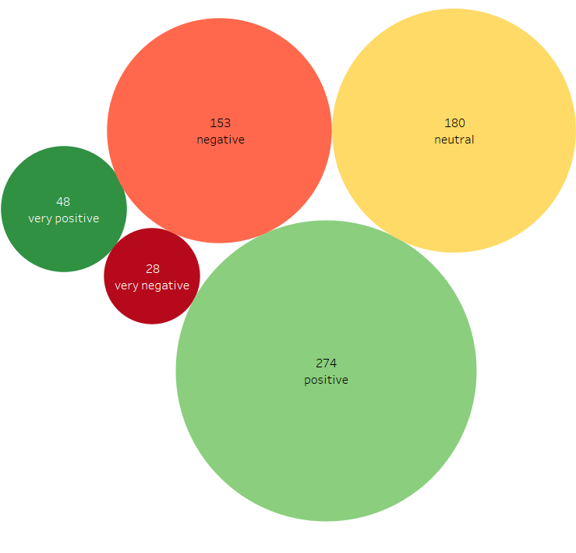
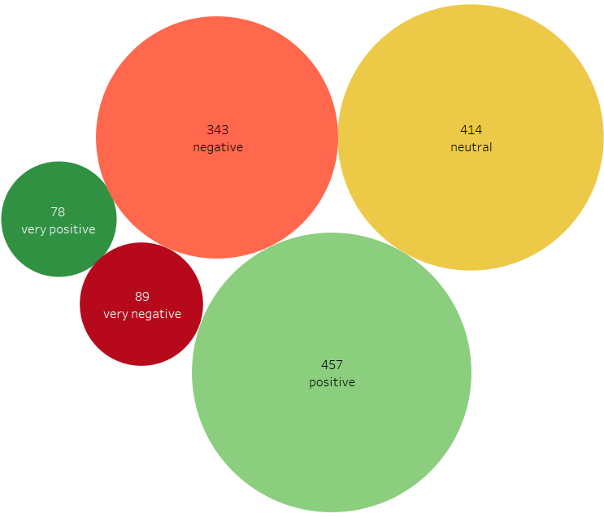
Competitive Landscape
FORD TESLA
Notes:
Let's revisit our sentiment analysis for Tesla and Ford, shedding light on how consumers perceive these automotive giants.
Ford's sentiment percentages remain consistently distributed. Positive sentiments constitute 47.14%, with 7.07% being very positive and 26% neutral
Tesla with a positive sentiment percentage at 45.33%, maintaining a positive reception in comments. This includes 5.68% very positive sentiments

Slide 12
Factors Influencing Sentiments
Positive Factors
Diverse Product Range: Ford's array of vehicles appeals to a broad consumer base, contributing to positive sentiments.
Long-Standing Reputation: Ford's established status in the automotive industry contributes significantly to a positive sentiment base.
Negative Factors/What Tesla is Doing Better
Electric Vehicle Perception: Ford's association with traditional combustion engine vehicles might lead to less positive sentiment.
Marketing and Branding Challenges: Ford may face hurdles in effectively marketing and branding when compared to Tesla and Elon Musk, potentially affecting how consumers perceive the brand.
Notes:
Positive factors for Ford extend beyond the product range, including its long-standing reputation. Being an established automaker, Ford benefits from a positive image built over decades, significantly contributing to a favorable sentiment base.
The diverse product range remains a strength, and Ford's active engagement strategies further contribute to maintaining positive sentiment levels.
However, challenges persist. Ford's association with traditional combustion engine vehicles might lead to less positive sentiment, especially in the context of the automotive industry's shift toward electric vehicles. Additionally, marketing and branding challenges may impact how consumers perceive the brand in the face of emerging industry trends.
Ford encounters marketing and branding challenges, particularly when compared to Tesla and the influential figure of Elon Musk. These hurdles could potentially shape how consumers perceive the Ford brand in the ever-evolving automotive landscape

Slide 13
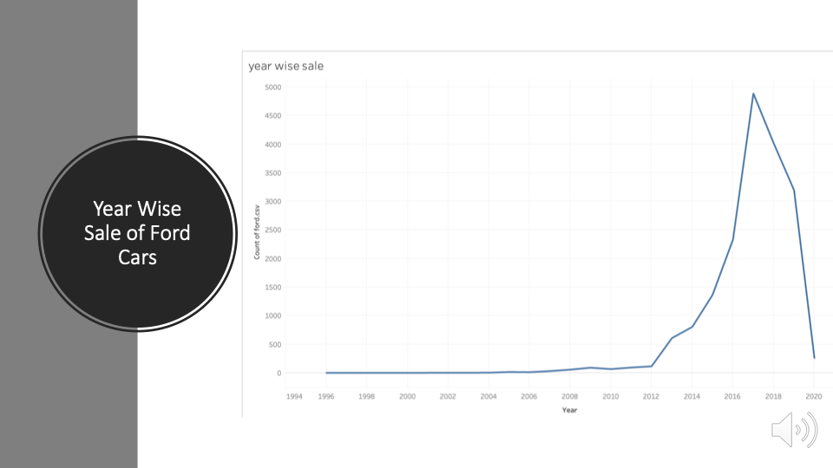

Slide 14
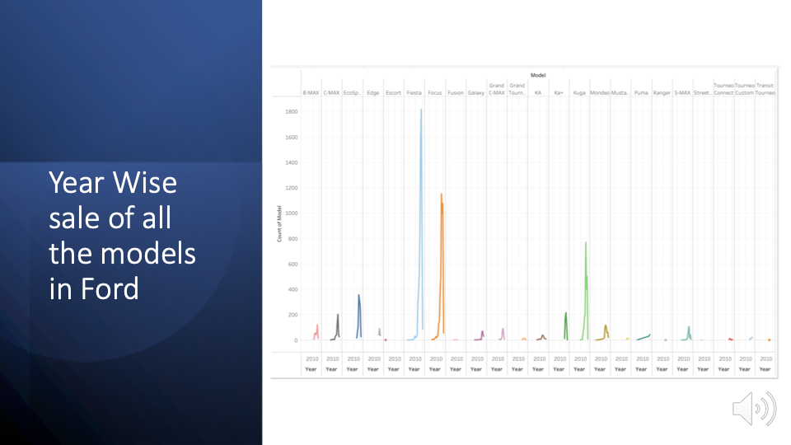

Slide 15
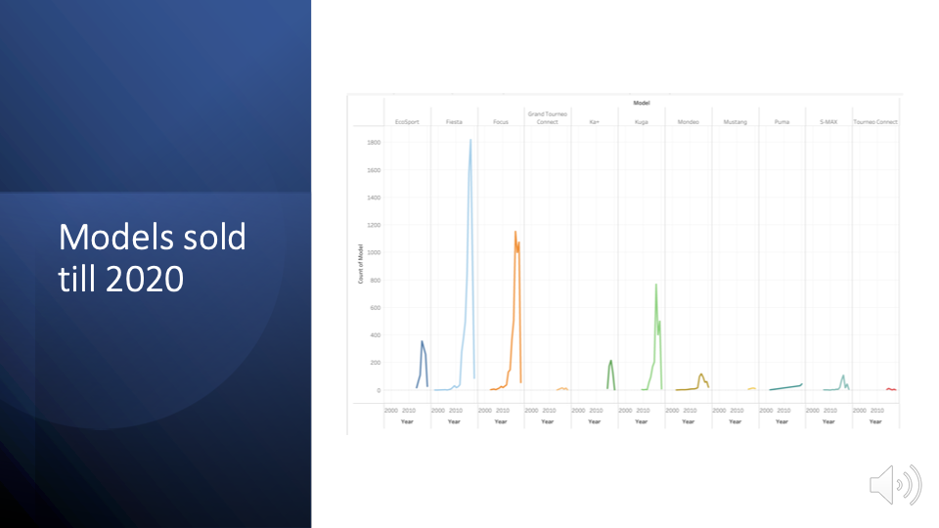

Slide 16
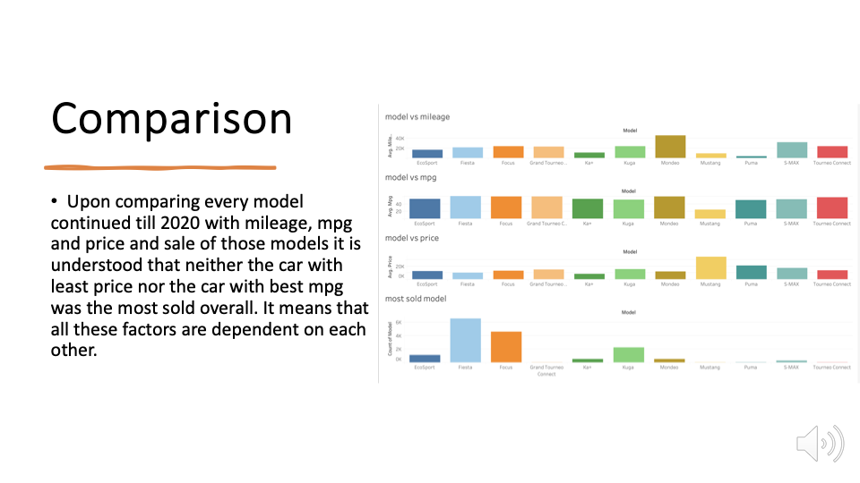

Slide 17
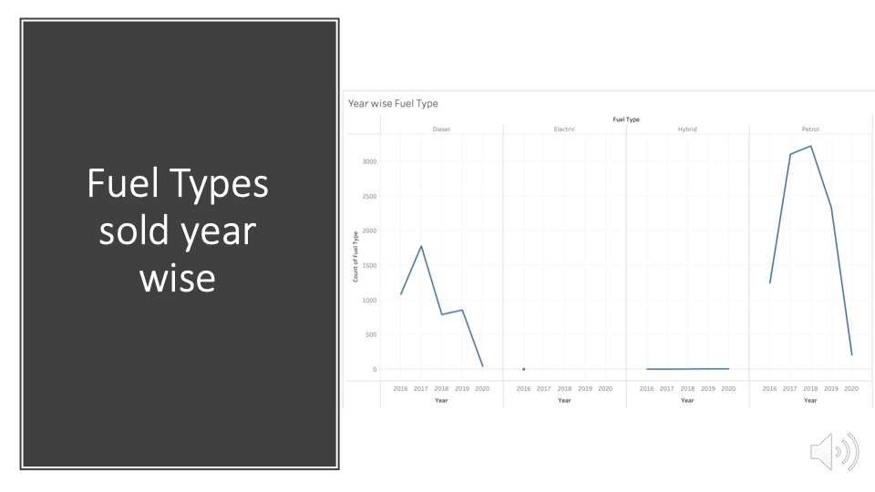

Slide 18
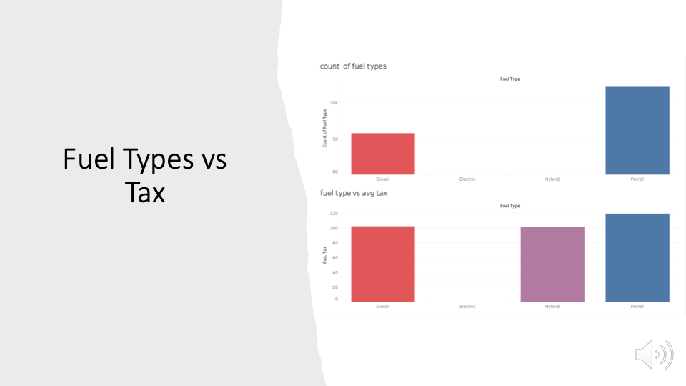

Slide 19
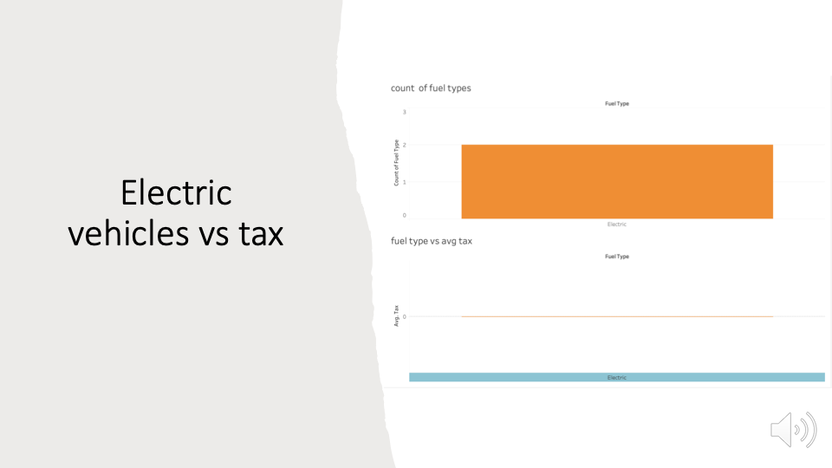

Slide 20
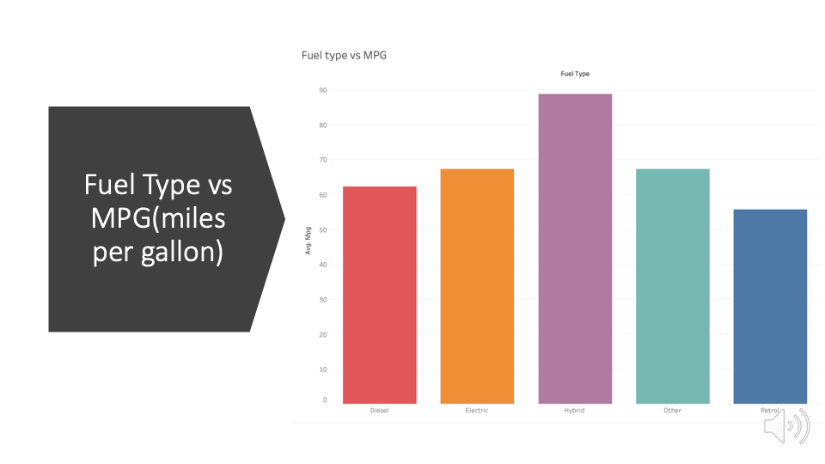

Slide 21


Slide 22
